Slide 1


- Exploratory Data Analysis
Results and Observations by vikas garg & Chacko mulackel

Slide 2
Agenda
OVERVIEW
EDA ROADMAP
ANALYSIS
RECOMMENDATIONS

Slide 3
overview
Lending Club is a peer to peer lending company based in the United States, in which investors provide funds for potential borrowers and investors earn a profit depending on the risk they take (the borrowers credit score). Lending Club provides the "bridge" between investors and borrowers.
LENDING CLUB
OBJECTIVE
Wants
Fears
Needs
The company wants to understand the driving factors behind loan default, i.e. the variables which are strong indicators of
default. The company can utilize this knowledge for its portfolio and risk assessment.
As a Data Scientist analyze the past dataset by using EDA to understand customer and loan patterns and their influence of not repaying loan on time or simply putting ‘Defaulting’
Be Profitable
Taking Unwanted Risks
EDA On Existing Dataset
Understand Customers
Losing Investment
To Find Bad Loans
Give Good Loan
Critical Variables To Help Give Good Loans

Slide 4
EDA Roadmap
Data Cleaning
1. Null Value
2 Removing unwanted Data
Univariate Analysis
1. Frequency
2. Distributions
(Categorical and Numerical)
Segmented
Analysis
1. Derive New Variables
2. Create Plots
Bivariate Analysis
1. Understanding how combination of variables estimates good loan’s
Finalize Variables/ SUMMARY

Slide 5
ANALYSIS

Slide 6
Data Cleaning Procedure
Column Reduction – Removal of columns with more than 65% missing values
Removing unimportant/ insignificant columns by intuition
Data Imputation – Converting NA/ NAN to suitable values
Data Correction – Removing bad data, e.g. Date columns
Correction in data type
Addition of newly derived columns

Slide 7
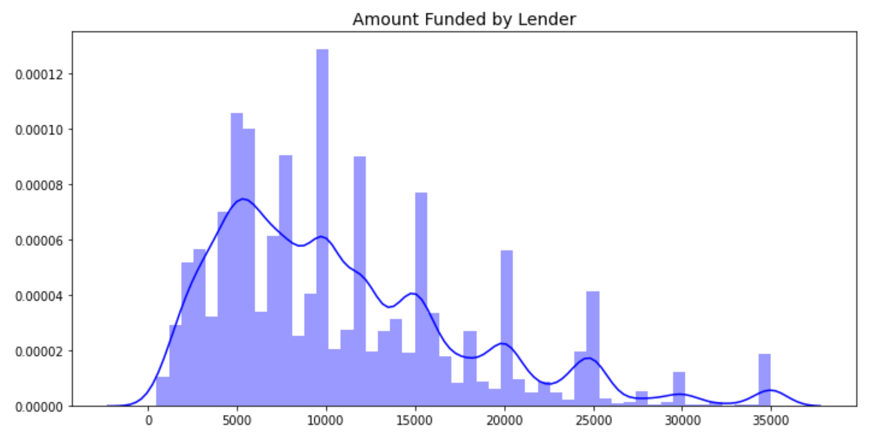
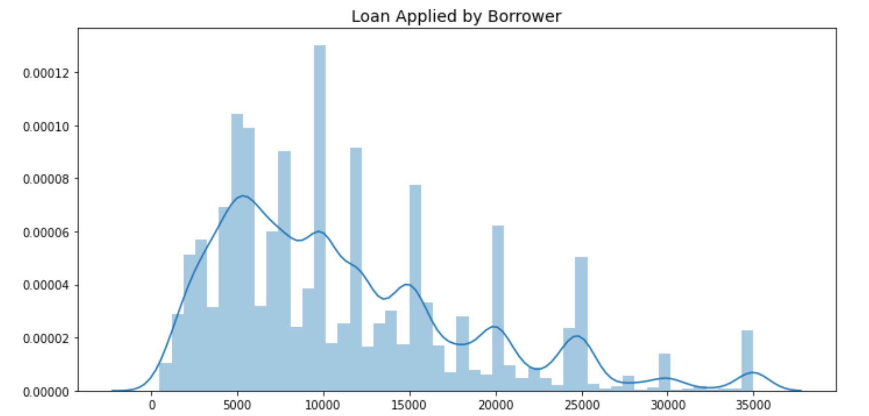
Loan distribution frequency
There are big difference while comparing the applied amount and the funded amount.
The year 2011 was having the highest amount of loan that got distributed.

Slide 8
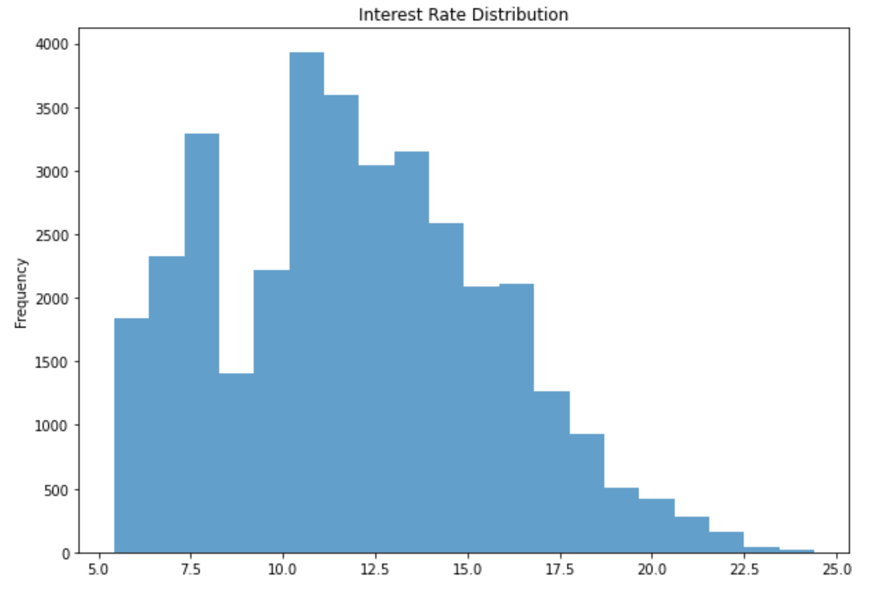
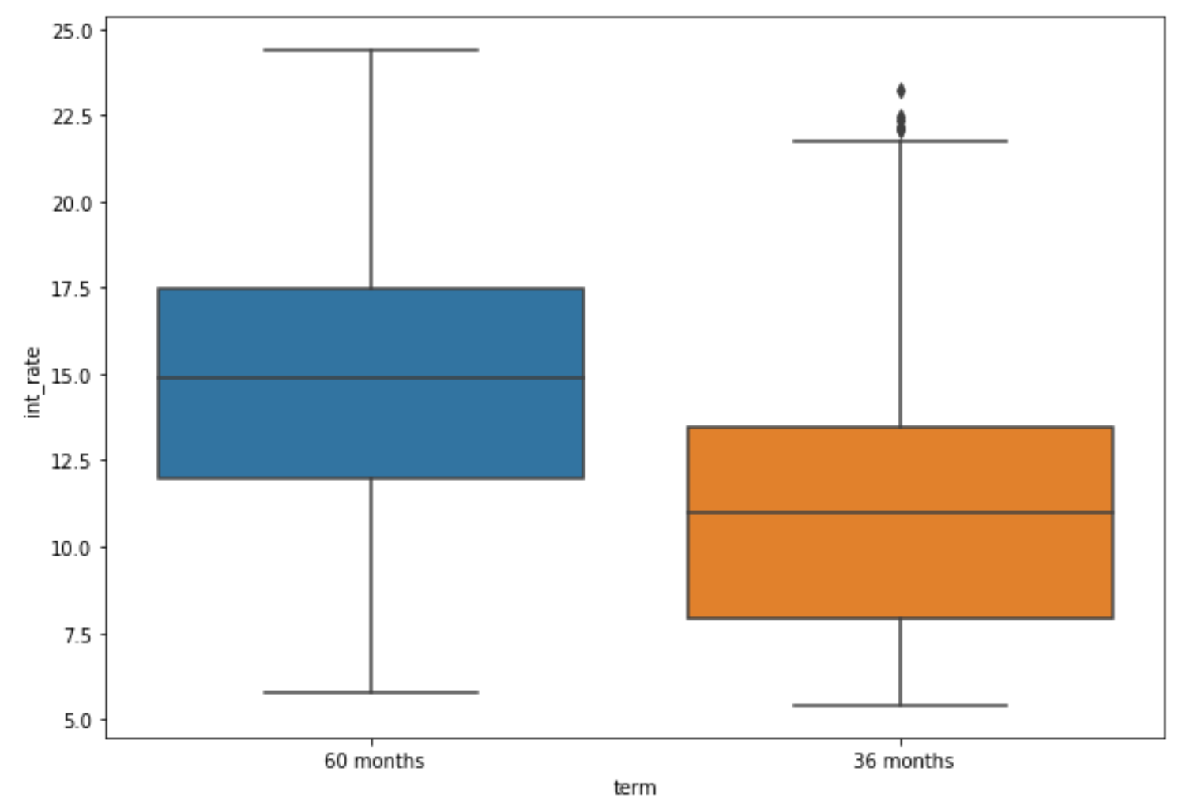
Interest rate distribution
Interest rate vary from 5.42% to 24.59%
High interest rates are associated with longer period loans

Slide 9
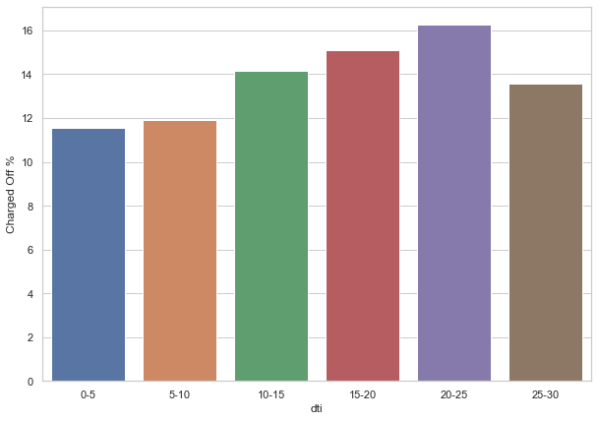
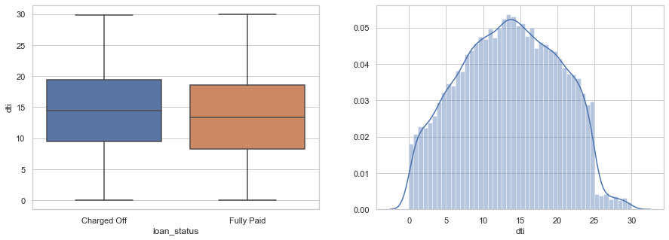
Charged off customers vs debt to income ratio
Charged off customers have comparatively high debt to income ratio.
Charged off customers are increasing slightly with respect to dti ratio so giving loan to customers with high dti will be more risky

Slide 10
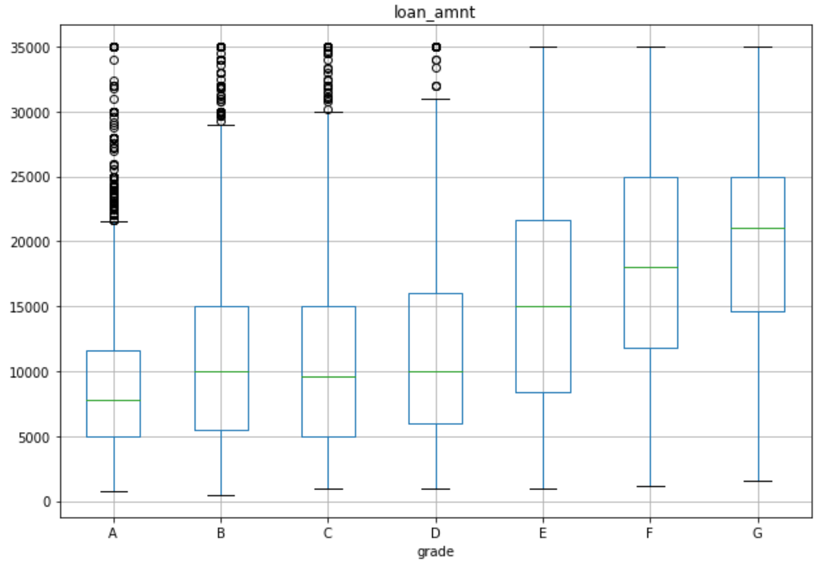
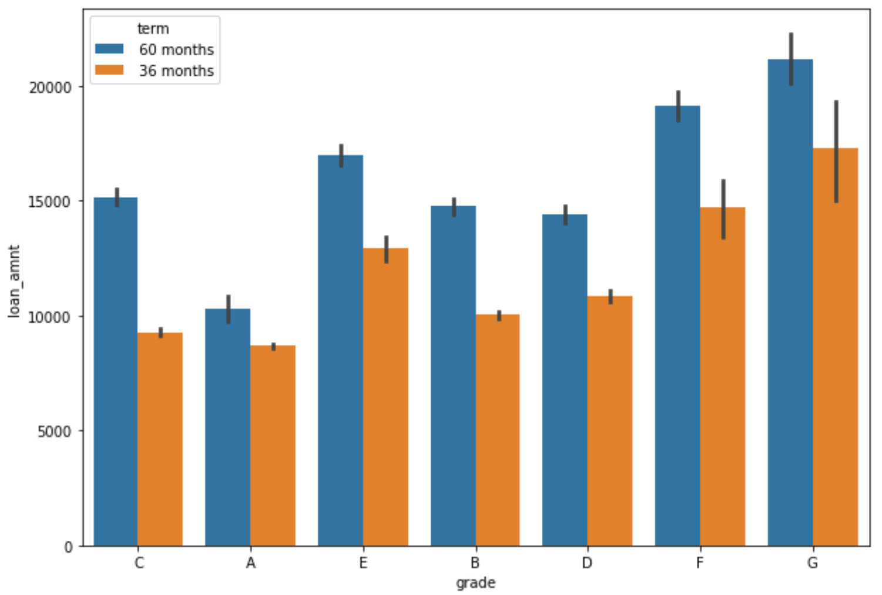
Relation of interest rate vs grades
Interest rate vary from 5.42% to 24.59%
The median loan amount for a grade G is higher than that of A,B or C grade types
Lower the grades higher the interest rate.

Slide 11
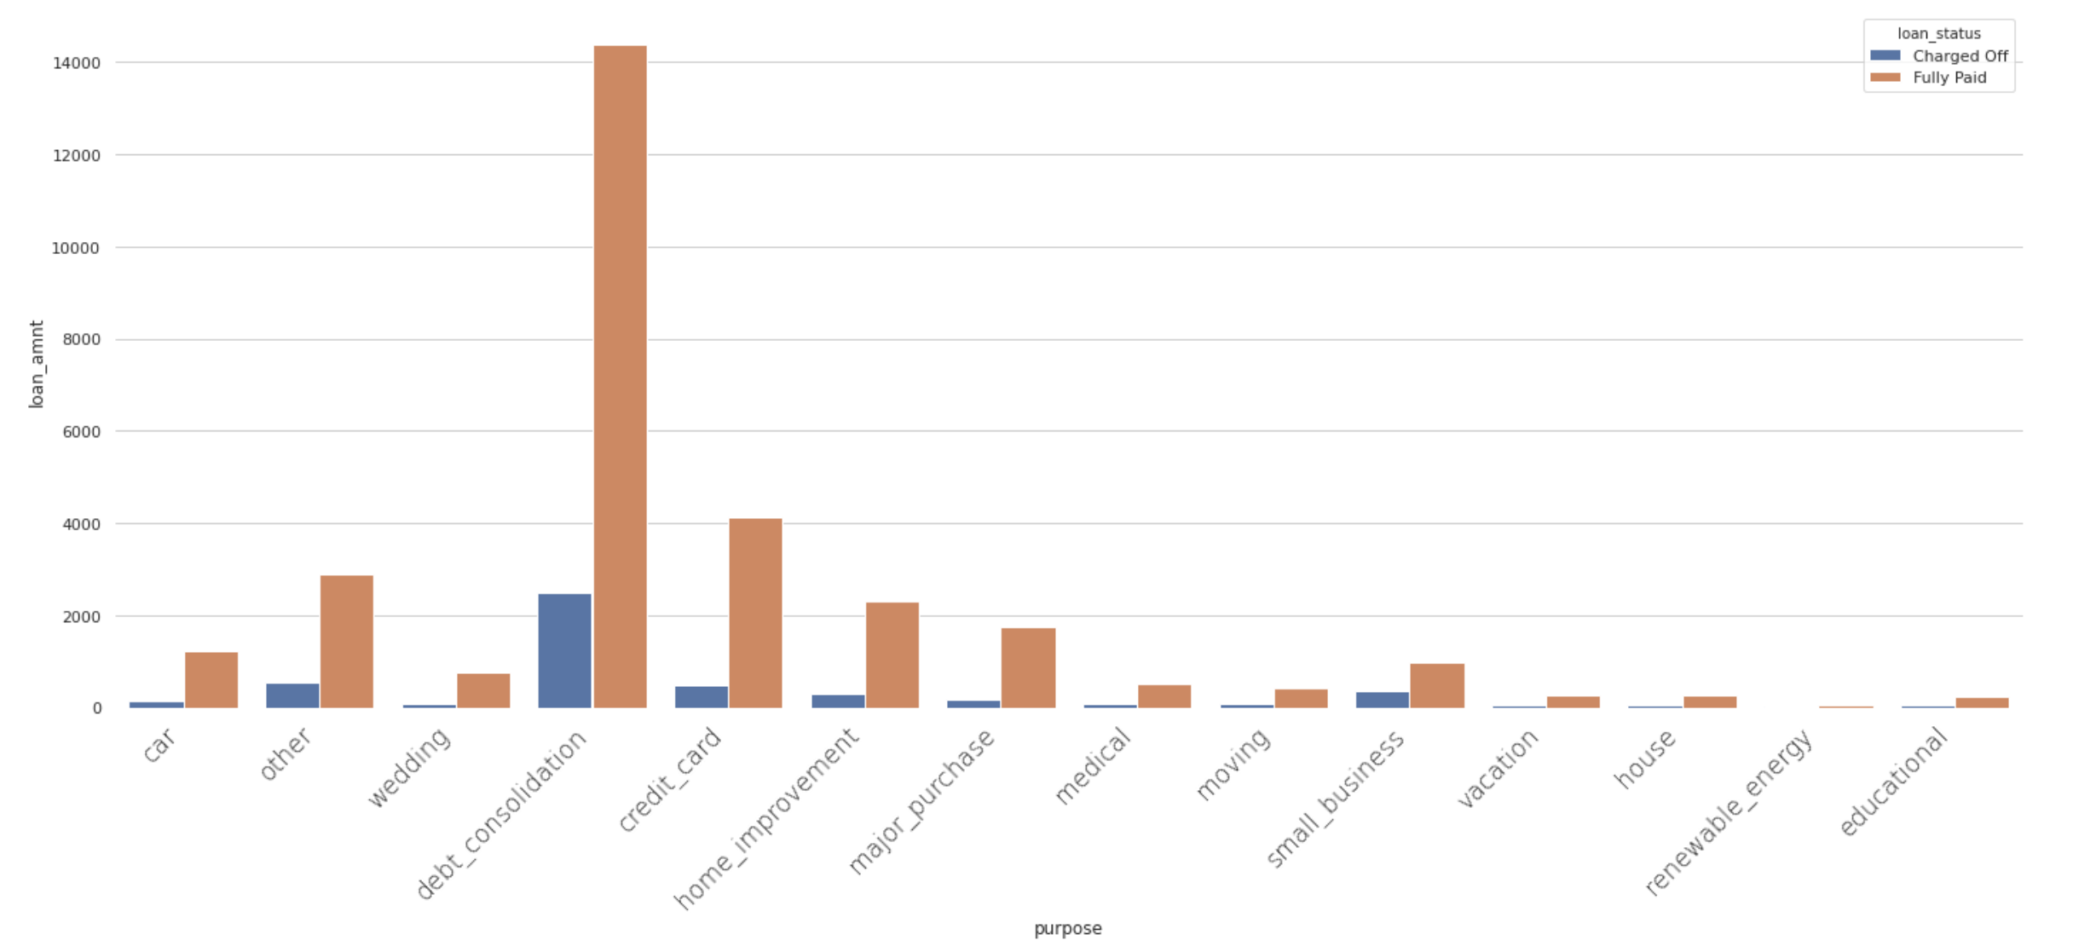
Loan Amount vs Purpose
Majority of the loans where taken for debt consolidation

Slide 12
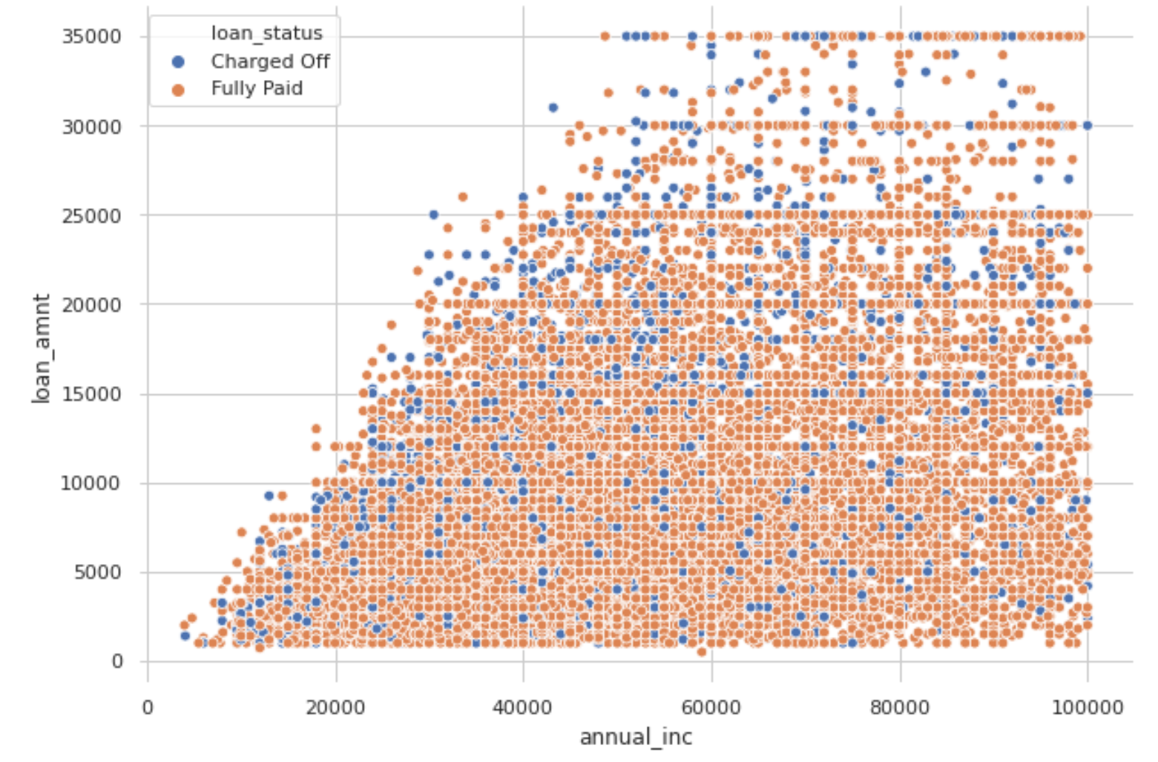
Annual income of defaulters and Good Loans
A large number of low income candidates where given bigger loan

Slide 13
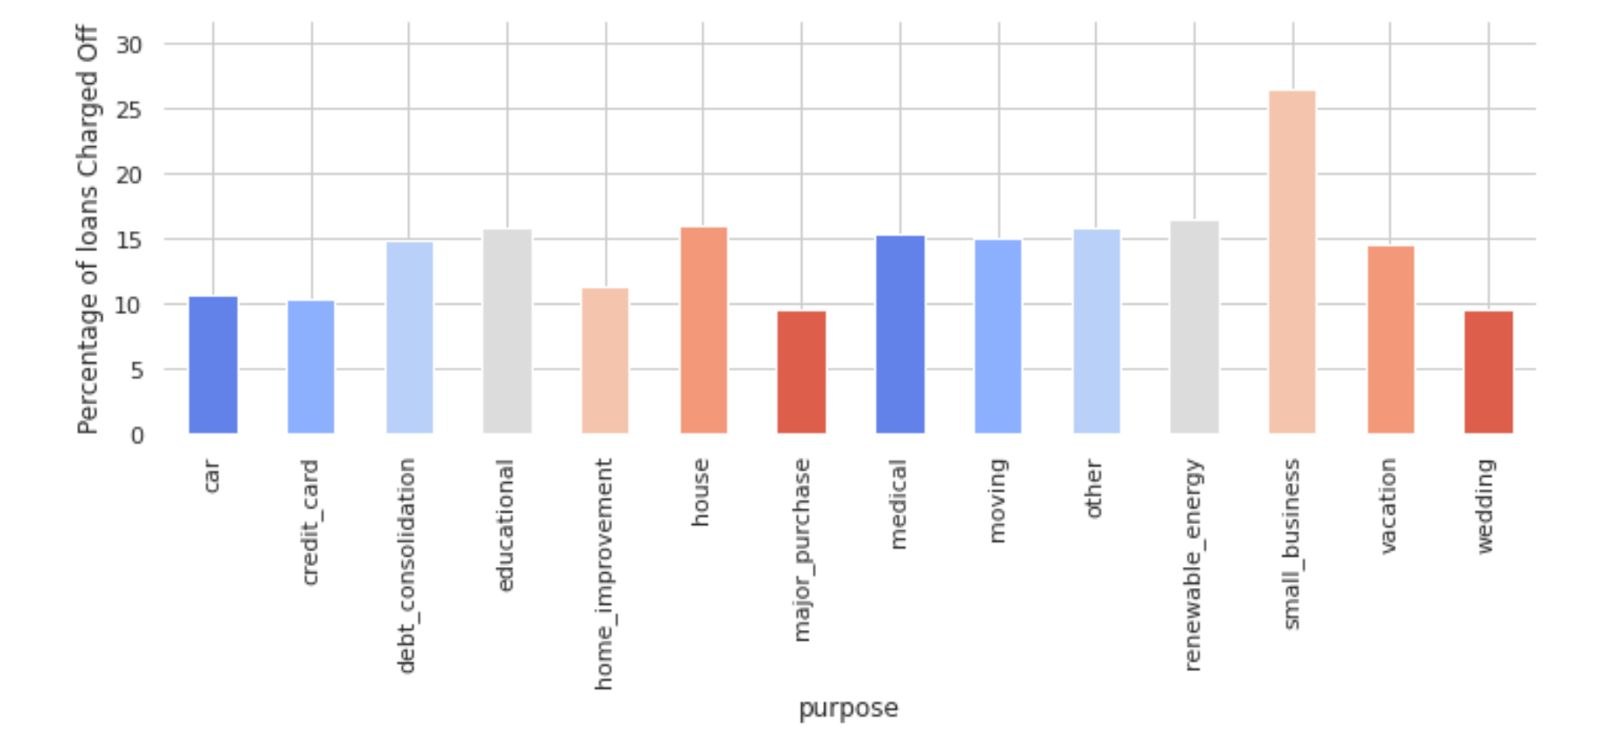
Annual income of defaulters and Good Loans
As you can see Small Business shows trends of defaulting

Slide 14

Recommendation based on findings
DTI
Approving loans where debt to income ratio higher than 30% will be risky and has to be diligent on such applicants.
SMALL BUSINESS
Small business shows the highest number of defaulters. The company have to hand pick applicants in this category
INTEREST RATES
Higher Interest rates should be imposed for candidates from small business and higher DTI
PRIOR RECORD
Giving loans to prior defaulters will be risky. Stringent background checks has to be done for such candidates

Slide 15
Thank you
Vikas Garg & Chacko Mulackel

